Slide 1

Loan Approval analysis
Uncovering hiding when it comes to loan approvals based on education and self-employment status

Slide 2
Key FINDINGS
After controlling for CIBIL score and income, approval rates were nearly identical across groups: graduates (62.45%) vs. non-graduates (61.98%), and self-employed (62.23%) vs. non-self-employed (62.20%). These marginal differences indicate no meaningful bias in loan approvals based on education or employment status.
Further analysis indicated that applicants with a CIBIL score of less than 550 (about 42% of applicants) have shown a loan approval rate of only 10.36%. While applicants with a higher CIBIL score have shown an above-average (more than 50%) loan approval rate. This simply tells us that creditworthiness is a much better predictor of loan approvals than education and employment status.
Among applicants with low CIBIL scores (under 550), short-term loans (≤4 years) had a 52.41% approval rate. Longer-term loans received zero approvals.

Slide 3
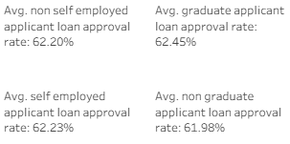
Loan approval rates by subcategory

Slide 4
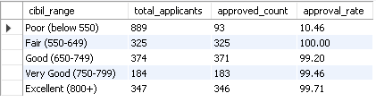
Approval rate by CIBIL SCORE
Applicants with poor CIBIL score rarely ever get their loans approved.
Applicants needed a decent CIBIL score to gain a better chance in getting their loan approved.

Slide 5
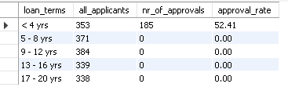
Applicants with A LOW CIBIL SCORE
Despite a poor CIBIL score, the majority of applicants applying for short-term and/or small loans get approved.

Slide 6
Recommendations
Ensure to build-up and maintain a good credit score.
For applicants with low credit scores, they should apply for small or short-term loans.

Slide 7
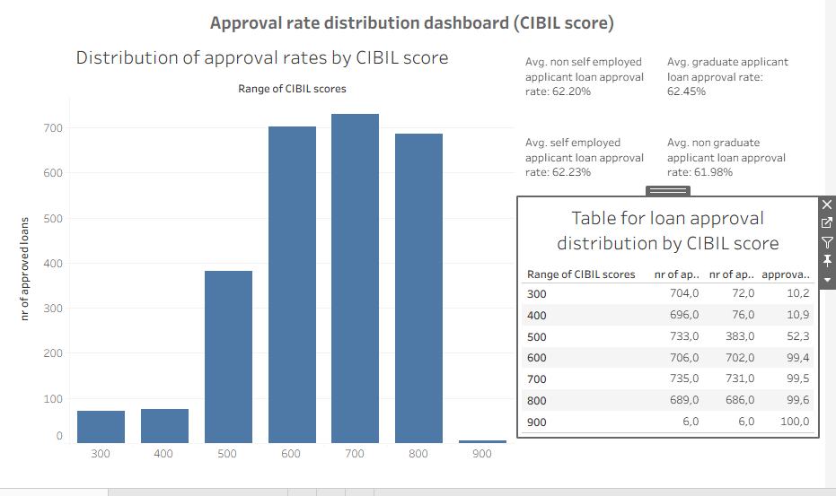
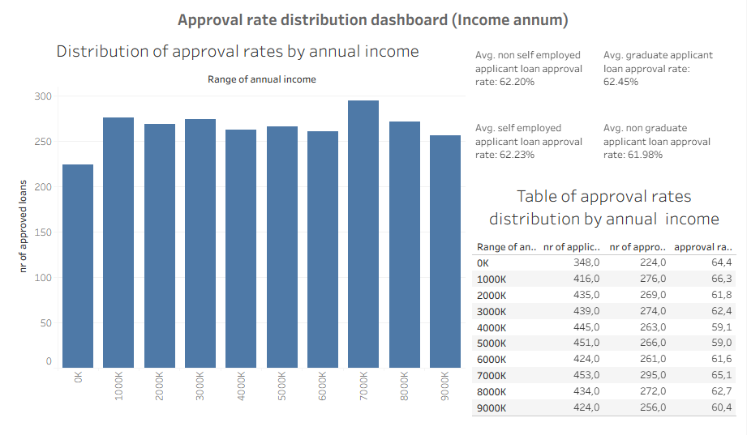
Dashboard Preview
Controlled for CIBIL score
Controlled for Annual Income

Slide 8
For an interactive dashboard
https://public.tableau.com/app/profile/aron.moganedi/viz/LoanApprovalBiasAssessment/Approvalratedistributiondashboardincomeannum/

